Slide 1


cloud deployment models

Slide 2
Cloud deployment models
“The cloud deployment model identifies the specific type of cloud environment based on ownership, scale, and access, as well as the cloud’s nature and purpose.”

Slide 3
history
NIST(National Institute of Standards and Technology) gave the four deployment models.

Slide 4
MODELS
Public Cloud
Private Cloud
Hybrid Cloud
Community Cloud
Multi Cloud

Slide 5











Use case
Public Cloud
Private
Cloud
Hybrid
Cloud
Community
Cloud
Using the public cloud expands the sharing and syncing capacities making it more accessible and backup of data is much simpler.
Private Cloud fetches data as per requirement of an application.
Hybrid Cloud manages traffic levels during peak usage periods.
Community Cloud allows systems and services to be accessible by a group of several organizations to share the information.

Slide 6





definition
Public Cloud
Private
Cloud
Hybrid
Cloud
Community
Cloud
Public Cloud is a open system where storage or software are available for free or pay per usage model that can be accessed via Internet.
Private Cloud means using a cloud infrastructure only by one customer or organization and is not shared with others.
Hybrid Cloud uses both public and private clouds on the purpose and requirements.
Community Cloud a shared cloud computing service environment that is targeted to a limited set of organizations or employees

Slide 7

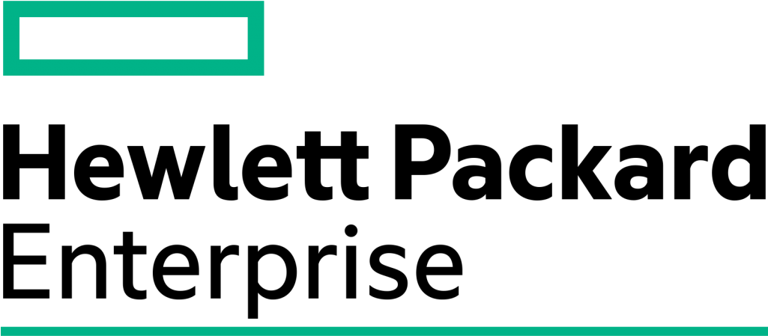

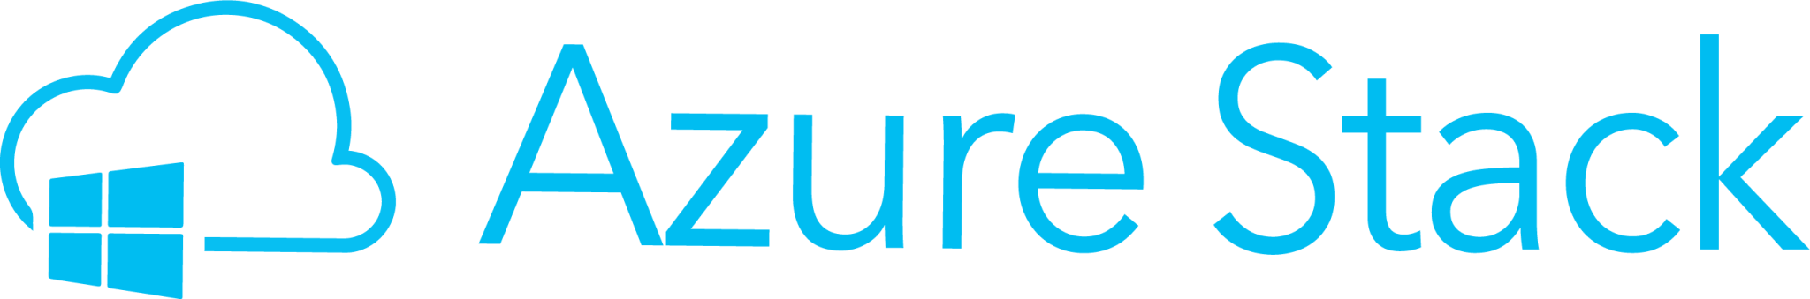
example
Public Cloud
Private
Cloud
Hybrid
Cloud
Community
Cloud
AWS is a public cloud that provides servers, storage, networking, remote computing, email, mobile development, and security.
The private cloud service provider offers customizable private cloud software and infrastructure.
Azure Stack is a portfolio of products that extend Azure services and capabilities to your environment of choice
USG Corporation, also known as United States Gypsum Corporation, is an American company which manufactures construction materials uses community cloud.

Slide 8


Tenancy (temporary ownership)
Public Cloud
Private
Cloud
Hybrid
Cloud
Community
Cloud
Multi Tenancy; data of many organization is stored in a shared environment.
Single Tenancy; data of a single organization is stored in the cloud.
The data stored in the public cloud is Multi-Tenant and is kept secure/private with the help of the private cloud.
Multi Tenancy; it enables different organizations to work on a shared platform.

Slide 9
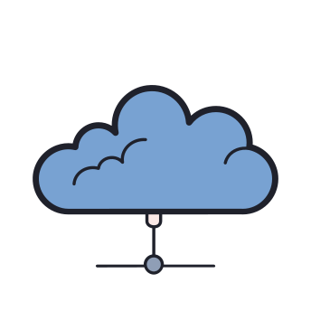



Exposure to public
Public Cloud
Private
Cloud
Hybrid
Cloud
Community
Cloud
Anyone can use the public cloud services.
Only a organization can use private cloud services.
The services running on the private user can only be accessed by organization.
Can be accessed by a group of organizations with similar interests.

Slide 10




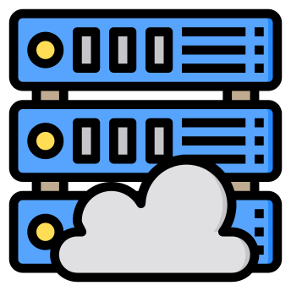




Data center locations
Public Cloud
Private
Cloud
Hybrid
Cloud
Community
Cloud
On the internet where cloud service providers are available.
Inside the organization network.
Inside the organization for private cloud services and anywhere on the internet for public cloud services.
Can be accessed by a group of organizations with similar interests.

Slide 11
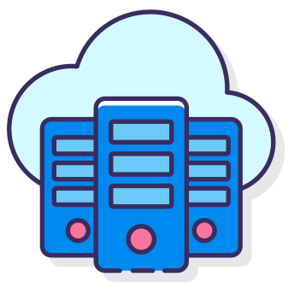




Cloud service manager
Public Cloud
Private
Cloud
Hybrid
Cloud
Community
Cloud
The cloud service providers manages the services whereas the organization uses them.
Organization needs to have their administrator to manage private cloud services.
The organization operates the private cloud whereas cloud service provider manage the public cloud.
Community Cloud is managed by the group of organization.

Slide 12



Hardware components
Public Cloud
Private
Cloud
Hybrid
Cloud
Community
Cloud
The cloud service provider provides all the hardware’s and ensures it’s working properly.
Organization offers the hardware, it buys all the physical server on which servers is built.
The organization provides the hardware for the private cloud whereas cloud services provider provides all hardware for public cloud.
The group of organizations collectively built and manages the hardware of the cloud.

Slide 13







Advantages
Public Cloud
Private
Cloud
Hybrid
Cloud
Community
Cloud
Lower costs
No Maintenance
Near Un-limited Scalability
High Reliability
More Flexibility
More Control
More Customization
Security
Control
Flexible
Cost Effective as compared to private cloud.
Ease
Cost Effective as compared to the private cloud.
Flexible
Security

Slide 14




Dis-Advantages
Public Cloud
Private
Cloud
Hybrid
Cloud
Community
Cloud
Compromised reliability
Data security and privacy issues give rise to concern
The lack of a bespoke service
Costly
Restricted Scalability
Security Risk
Maintenance
Difficult Integration
High cost compared to the public deployment model
Sharing of fixed storage and bandwidth capacity
Not commonly used yet

Slide 15

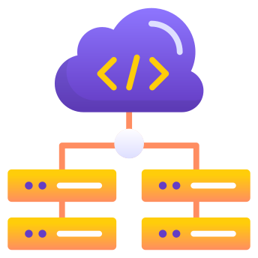
advantages
Multi Cloud
Multi Cloud provides multiple cloud providers at the same time under this paradigm, as the name implies.
It’s similar to the hybrid cloud deployment approach, which combines public and private cloud resources. Instead of merging private and public clouds, multi-cloud uses many public clouds.
Reduced Latency
High Availability of Resources

Slide 16
Cloud computing deployment: a cost-modelling case-study
Research
Paper
Authors : Jeremy Ellman, Nathan Lee, Nanlin Jin
General : Wireless Networks
In this research paper they proposed a new costing model that systematically evaluates cloud services, and which combines compute, disk storage, and memory requirements.
They proposed costing model on a data set that was derived from a real-world industrial data center workload by calculating the precise cost of service provision from two leading cloud providers.
This evaluation shows that Cloud Computing costs may vary by up to 17% when comparing compute service providers.

